Slide 1


Data-Driven Recruitment System
Optimizing Biased Talent Acquisition Through Data-Driven HR Analytics

Slide 2
Modeling

Slide 3

Baseline Model
Logistic Regression
Simple and Fast: This algorithm is very easy to train and allows you to quickly evaluate initial performance without the need for complex tuning.
Ideal for Simple Linear Trends: Works best when the relationship between features (such as test scores or experience) and selection outcomes is linear. For example, the higher the interview score, the greater the probability of a candidate being hired.
Stable and Consistent: Its predictions are not easily affected by small changes in the data, making it a fair benchmark for complex models like XGBoost.
Flexible with Imbalanced Data: Easily configurable to handle imbalanced datasets, a very common condition in real-world recruitment scenarios.
F1 Score
72.3%
ROC AUC
88.6%

Slide 4
Model Experiment
Model | Accuracy | Precision | Recall | F1-Score | ROC-AUC
Random Forest | 0.898 | 0.843 | 0.791 | 0.816 | 0.910
Gap(%) | 10.222 | 15.702 | 20.930 | 18.400 | 8.969
XGBoost | 0.882 | 0.797 | 0.791 | 0.794 | 0.899
Gap(%) | 11.778 | 20.312 | 20.930 | 20.623 | 10.131
Logistic Regression | 0.862 | 0.853 | 0.628 | 0.723 | 0.886
Gap(%) | 4.114 | 5.073 | 27.545 | 18.015 | 6.914
Decision Tree | 0.809 | 0.635 | 0.783 | 0.701 | 0.801
Gap(%) | 19.111 | 36.478 | 21.705 | 29.861 | 19.887
K-Neighbors | 0.613 | 0.381 | 0.558 | 0.453 | 0.625
Gap(%) | 19.549 | 38.894 | 32.281 | 36.885 | 28.845

Slide 5
Hyperparameter Tuning
Model | Accuracy | Precision | Recall | F1-Score | ROC-AUC
XGBoost | 0.913 | 0.857 | 0.837 | 0.847 | 0.913
Random Forest | 0.873 | 0.765 | 0.806 | 0.785 | 0.894
Decision Tree | 0.864 | 0.739 | 0.814 | 0.775 | 0.889
Logistic Regression | 0.778 | 0.574 | 0.868 | 0.691 | 0.881
K-Neighbors | 0.636 | 0.407 | 0.597 | 0.484 | 0.653
Hyperparameter tuning was performed using the RandomSearchCV method with cross-validation 5.
For complex algorithms like XGBoost or Random Forest was time-consuming.
Bayesian methods produce sub-optimal results.
RandomizedSearchCV is easier to implement and debug if errors occur.

Slide 6
Hyperparameter Tuning (Gap %)
Model | Accuracy Gap(%) | Precision Gap(%) | Recall Gap(%) | ROC-AUC Gap(%) | F1-Score Gap(%)
XGBoost | 6.286 | 12.857 | 12.918 | 7.835 | 12.890
Random Forest | 4.754 | 16.643 | 10.276 | 7.106 | 13.501
Random Forest has the smallest Accuracy Gap (4.75%). However, XGBoost remains highly competitive with a stable gap across the board, including a solid ROC-AUC Gap of (7.83%), which ensures the model's performance on real-world hiring data will be predictable and measurable.
Most gap metrics for both models are now within an acceptable and safer range (10% - 14%). This consistency shows that the model has successfully learned general patterns from the dataset of 1,500 candidates.
Overall, XGBoost is the preferred choice because it maintains the best balance between high predictive power and a stable gap, particularly in ROC-AUC, making it the most reliable model for the Hiresights recruitment system.

Slide 7
Best Model: XGBoost
Model | Accuracy | Precision | Recall | F1-Score | Dataset | ROC-AUC
XGBoost | 0.976 | 0.986 | 0.966 | 0.976 | Train | 0.991
XGBoost | 0.913 | 0.857 | 0.837 | 0.847 | Test | 0.913
XGBoost | 6.286 | 12.857 | 12.918 | 12.890 | Gap (%) | 7.835
XGBoost demonstrated good model stability with an Accuracy Gap of (6.28%). This indicates that the model has adequate generalization capabilities for new data in the future.
XGBoost achieved scores of F1-score (84.7%) and ROC-AUC (91.3%) on the competitive test set, demonstrating its ability to accurately identify potential candidates.
Value | Best Hyperparameter
50.0 | reg_lambda
300.0 | n_estimators
6.0 | max_depth
0.1 | learning_rate
0.2 | gamma
Before Hyperparameter Tuning
F1 Score: 79.4%
ROC-AUC: 89.9%
After Hyperparameter Tuning
F1 Score: 84.7%
ROC-AUC: 91.3%

Slide 8
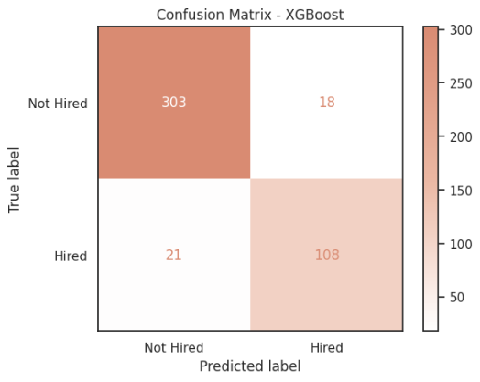
Confusion Matrix
The model correctly identified the majority of the data. Of the 450 data points, the model only incorrectly predicted 39.
The model successfully identified 108 of the 129 candidates who were actually Hired. There were 21 potential candidates missed (predicted as Not Hired), indicating room for improvement to capture more talent.
Based on the Confusion Matrix, the XGBoost model demonstrated solid performance in the recruitment process with a high level of accuracy and minimal misclassification.

